Slide 1

P-467 REAL OR FAKE NEWS ANALYSIS
Group - 4
Prathamesh Suryawanshi (prathameshsuryawanshi9090@gmail.com)
Sai Rakesh A.V. (avrakesh01@gmail.com)
Babu Muthuraman (babubasker320@gmail.com)

Slide 2

Real or Fake
News Analysis
This dataset consists of about 40000 articles consisting of Fake as well as Real
news. Our aim is train our model so that it can correctly predict whether a
given piece of news is real or fake. The fake and Real news data is given in two
separate datasets with each dataset consisting around 20000 articles each.

Slide 3
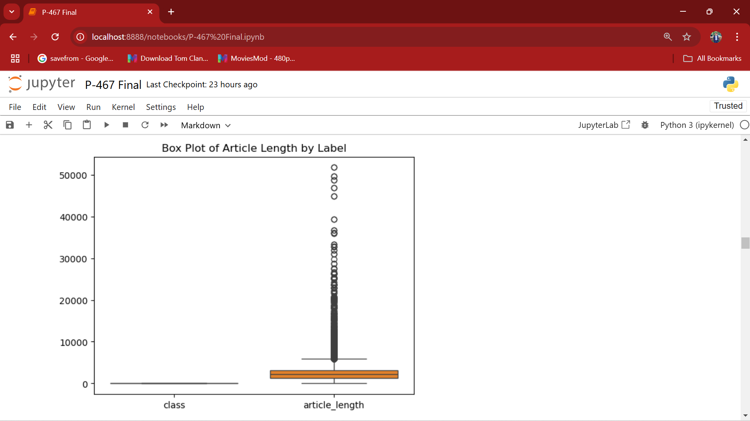
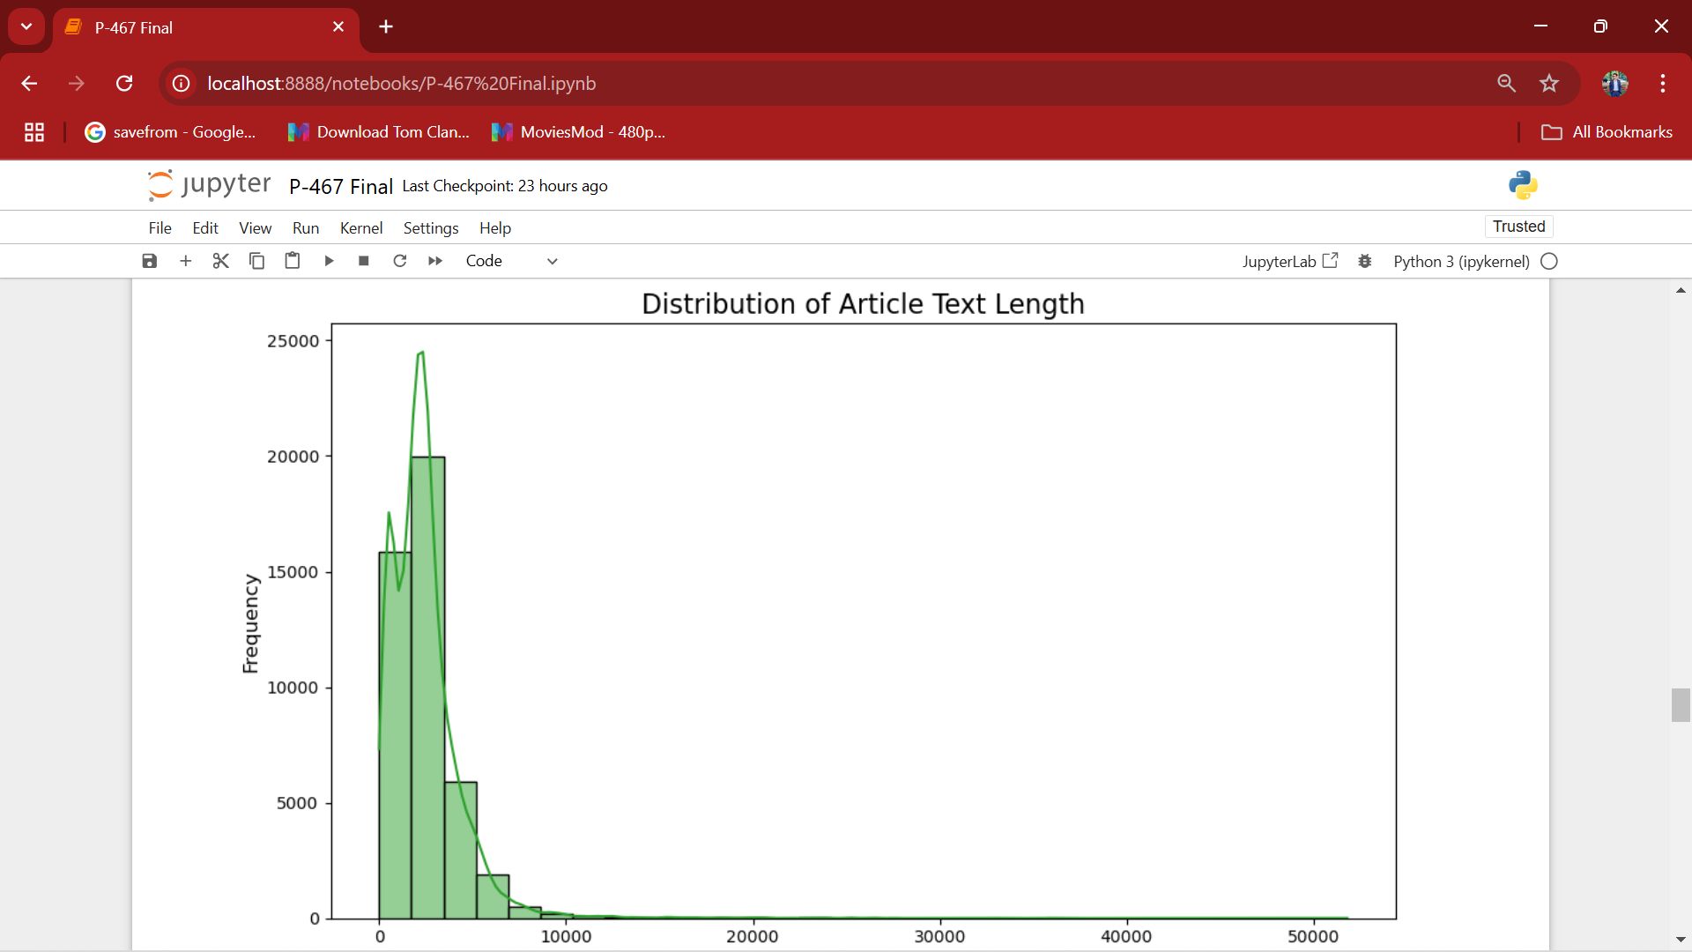
Methodology
Exploratory Data Analysis (EDA)
Data Shape : (23462, 5) ,(21411, 5)
Duplicate Rows : 209
There are some null values and some duplicate values.

Slide 4
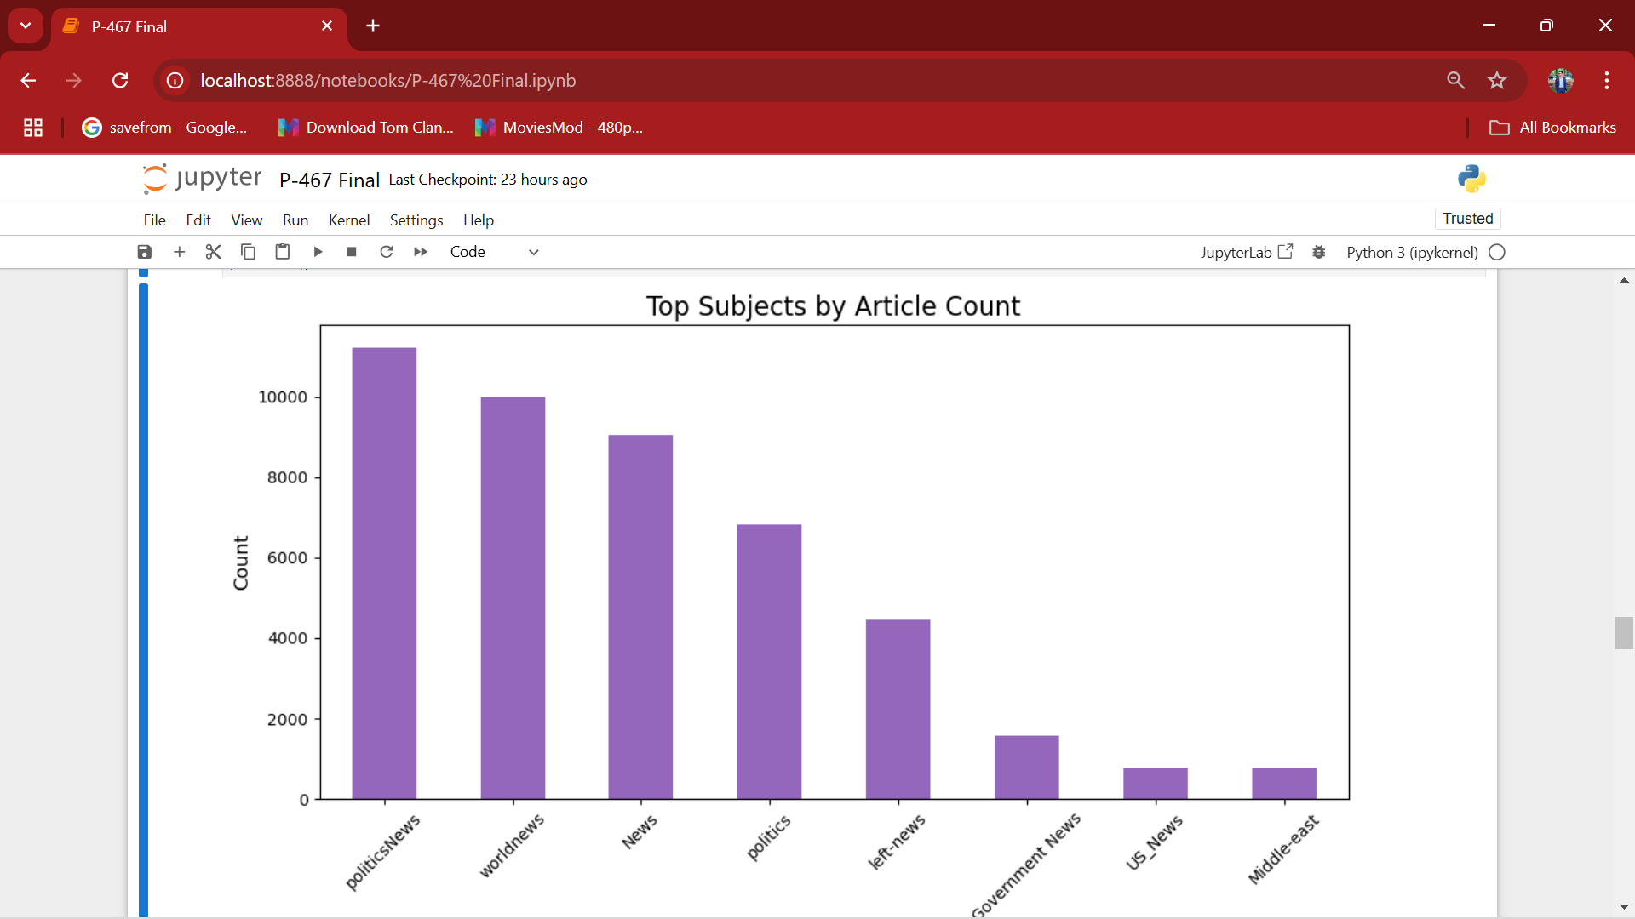
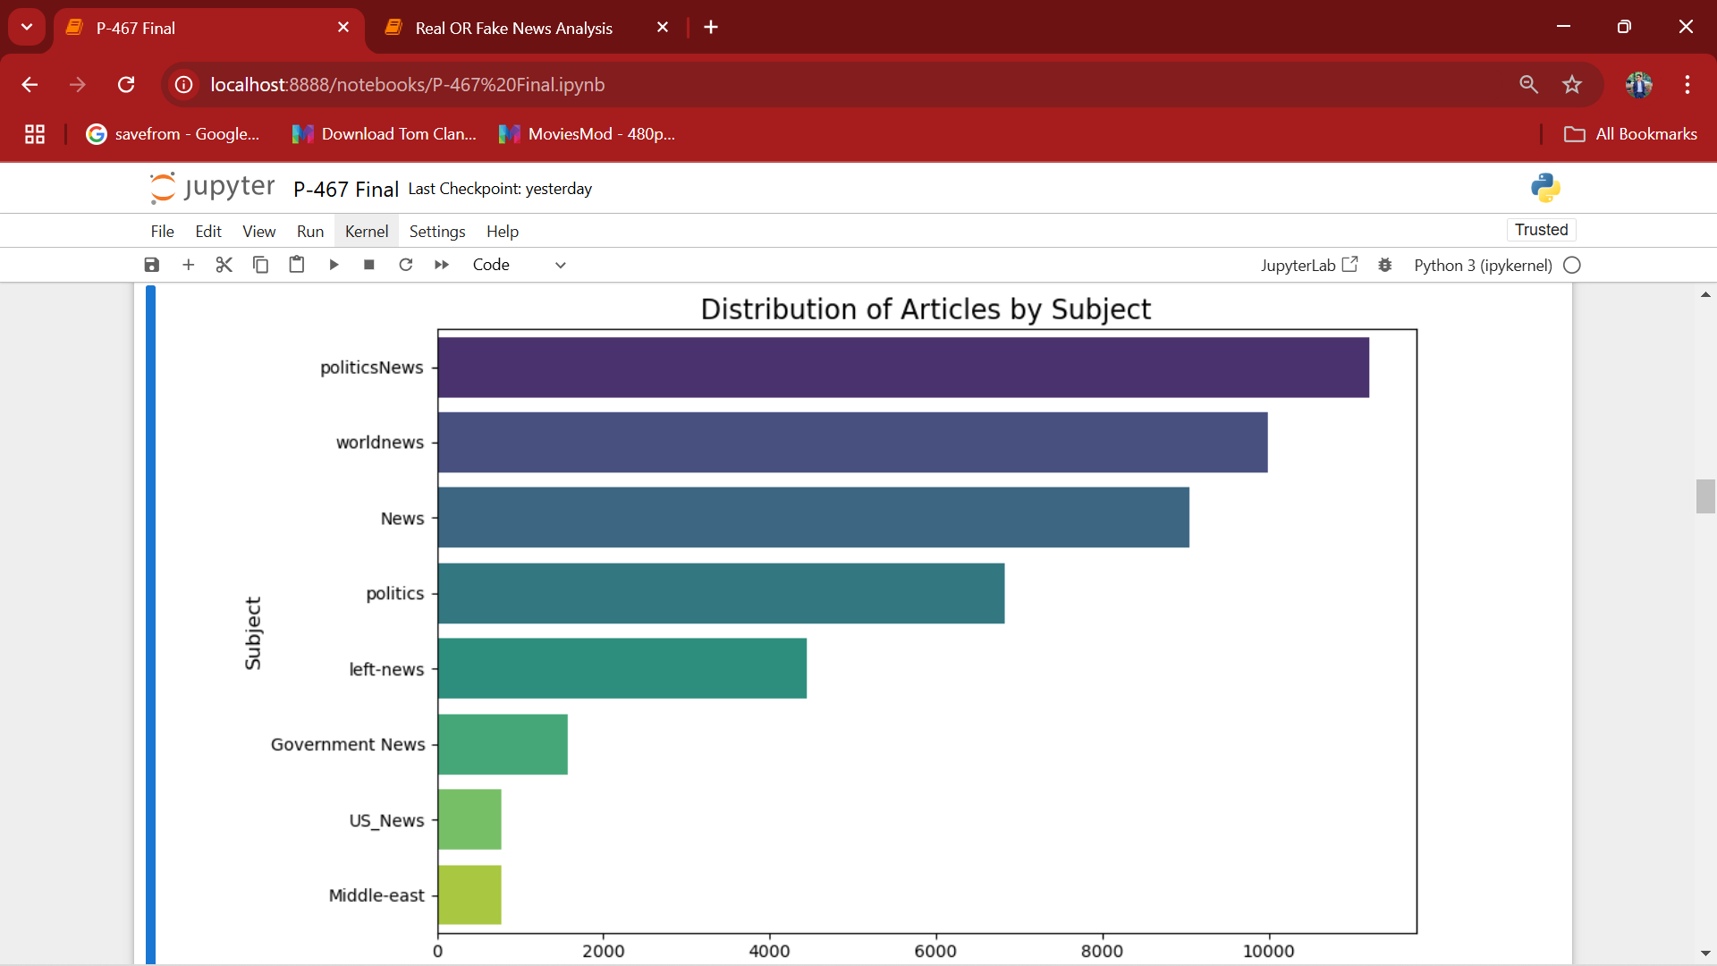
Model Building / Evaluation
Dropped unwanted columns .
Splits the data into training and testing.
Create different models like Logistic Regression, Random Forest.
Evaluated model performance using Accuracy, Precision, Recall, F1 Score.
Random Forest get best accuracy.

Slide 5
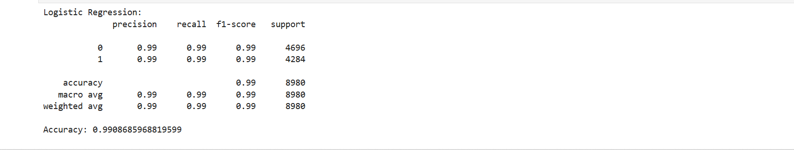
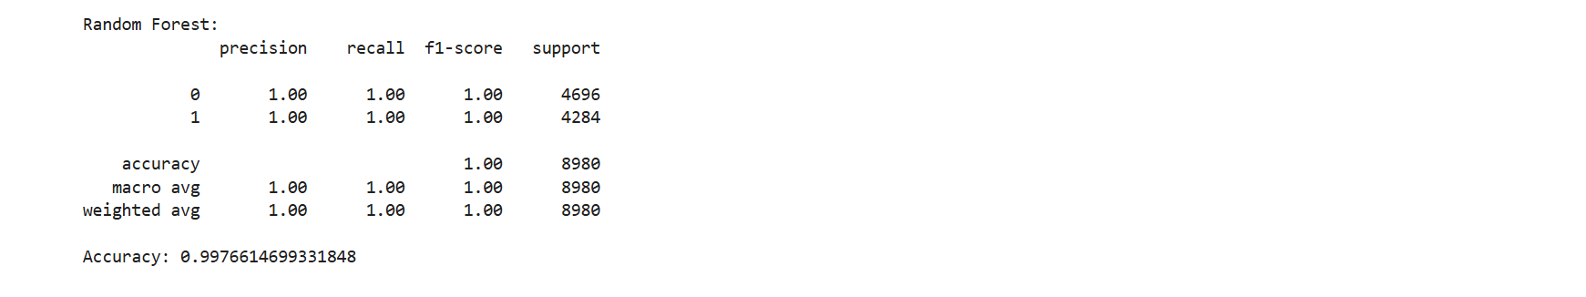
Models with Accuracy

Slide 6
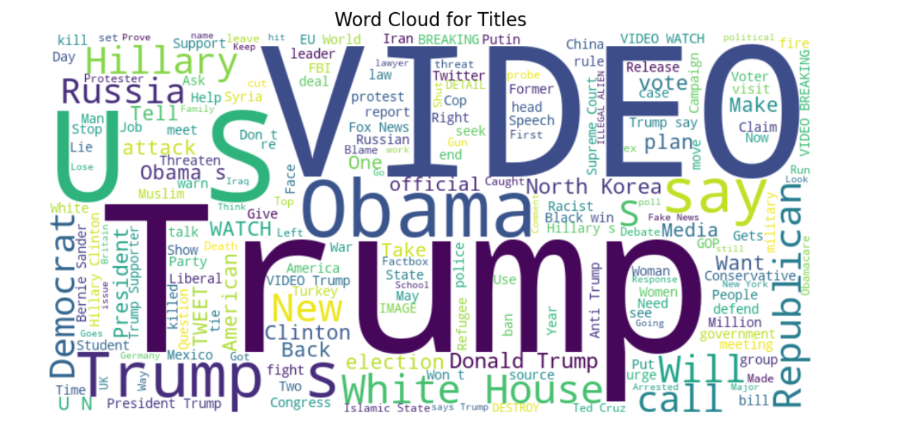
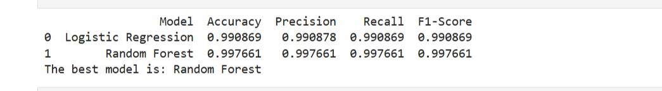
Result
Model : Random Forest
Data Partition details : Using sklearn train test split with ratio of 80:20
Random Forest Classifier Details :
For True or Fake news analysis, this model likely performed well due to its ability to handle various features and detect complex patterns. It provides insights into which features are most influential for predicting correct news. Its ensemble approach often results in higher accuracy compared to individual models.

Slide 7
Challenges faced :
Data Understanding .
Working on 2 different dataset.
Model Overfitting.
Stream lit issue.
How did you overcome ?
Git hub used for fie sharing , dynamic work progress updates.
Get help of mentor.
Team worked together.

Slide 8
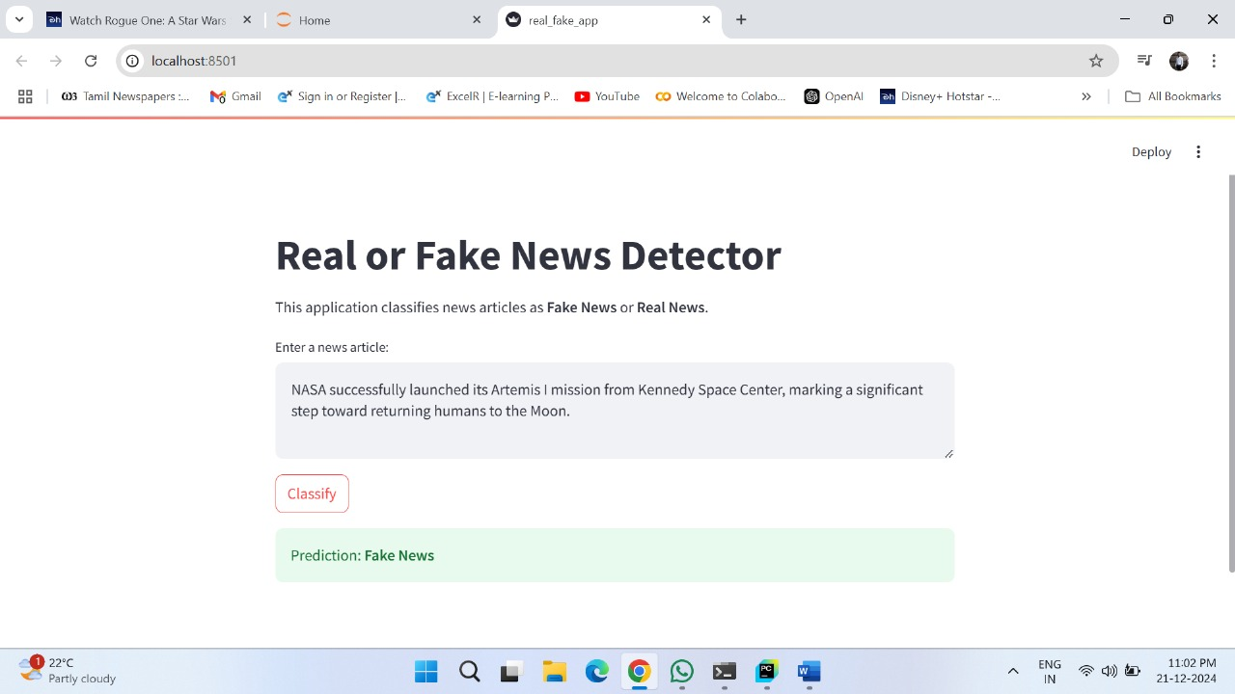
Web App Deployment using Streamlit

Slide 9

Thank You!
We are grateful for the opportunity to share our insights with you.

